Slide 1
Assignment - Acquisition Analytics SUBMISSION
Submitted By:
Anshul Srivastava

Slide 2
<Abstract>
Objective
To predict the probability of response of each prospect and target the ones most likely to respond to the next telemarketing campaign
Constraints
Achieve 80% of total responders at the minimum possible cost
45,000 data points.
Analysis
Exploratory Data Analysis
Cost Analysis
Building Response Model
Source
- Upgrad.com

Slide 3
<Problem solving methodology>
Data Extraction
Understanding Data
Data Preparation
Understanding Business Objective
Data Visualization
Data Analysis
Data Evaluation
Use flow chart

Slide 4
<Exploratory Data Analysis>
Objective
To identify best suited variables for the prospect Identification
Approach
- By identifying key variables and segmenting them into proper bucktes
Constraints
Reach out to 80% of total responders in minimum cost.
Results
the youngest and the eldest are the most likely to buy the investment product.
student and retired have the highest response rates.
prospective customers contacted through cellular medium are significantly ore likely to opt in to the investment scheme
negative employment variation rate seems to be related to higher response rates

Slide 5
<Model Building (Response Model)>
Objective
To identify best model out of Logistic Regression, Decision Tree and Random Forest for building response model.
Approach
By looking at metrics like Accuracy, Sensitivity and Specificity of models, finding best model
Results
Logistic Regression turns out to be the best model as it is simple and robust at times.
With an accuracy of 72% and all other metrics like precision and recall at their best.
Implementing this model as our response model for the acquisition of prospected customers.
Conclusion
Even though Random forest was giving much higher accuracy but at the cost of over fitting.

Slide 6
Cost Analysis
decile | total | actual | cumresp | gain | cumlift | cost | cumcost
1 | 1236 | 569 | 569 | 41.17221 | 4.117221 | 6074 | 6074
2 | 1236 | 259 | 828 | 59.91317 | 2.995658 | 5437.8 | 11511.8
3 | 1235 | 117 | 945 | 68.37916 | 2.279305 | 5323.9 | 16835.7
4 | 1236 | 92 | 1037 | 75.03618 | 1.875904 | 5329.25 | 22164.95
5 | 1235 | 66 | 1103 | 79.81187 | 1.596237 | 5133.233 | 27298.18
6 | 1236 | 68 | 1171 | 84.73227 | 1.412205 | 4849.917 | 32148.1
7 | 1236 | 75 | 1246 | 90.15919 | 1.287988 | 5235.2 | 37383.3
8 | 1235 | 64 | 1310 | 94.79016 | 1.184877 | 4951.417 | 42334.72
9 | 1236 | 39 | 1349 | 97.61216 | 1.08458 | 5211.283 | 47546
10 | 1236 | 33 | 1382 | 100 | 1 | 5098.183 | 52644.18
From the Dataframe attached above, to reach out to 80% of respondants we only have to contact 50% of the total test population.
Since the cost of every decile is also predicted, we can predict cost for acquiring customers.
80% of respondant = 1103 from 1382 respondants
50% of test population = 6178 from 12537 test population
Actual population = 45000 approx.
Reach out to 50% of Total Population = 22500
Cost of reaching out to 50 % of test population = ₹ 27,300
Cost of reaching out to Total population = (Cost of Reaching out to single Customer) * (50% Total Population)
= (27300/6178) * (22500)
= ₹ 99,425.0
= ~ ₹ 1 Lac

Slide 7
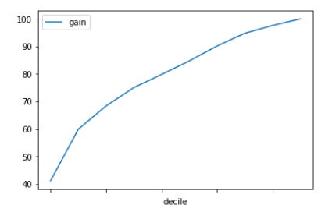
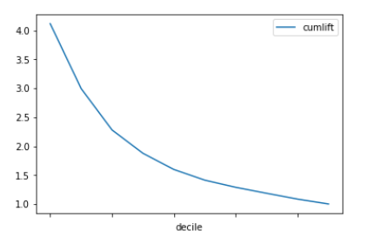
Lift Chart & Gain Chart
Gain Chart – Only reaching out to 50% of the population we can get 80% of our respondents.
Lift Chart - Even at 50% of the population our model is 1.5 X times better than reaching the entire population.

Slide 8
<Conclusions>
With constraints of reaching out to 80% of the total respondents from the entire population along with minimum cost investment. Our recommendations are as follows:
the youngest and the eldest are the most likely to buy the investment product.
student and retired have the highest response rates.
prospective customers contacted through cellular medium are significantly ore likely to opt in to the investment scheme
negative employment variation rate seems to be related to higher response rates
50% of the entire population of 45000 approx. have to be targeted to reach out to 80% of total respondents.
Average call duration will be around 255 seconds = ~6 minutes
Cost of Acquisition = 1 Lac approx.

